Slide 1

SALES
ANALYSIS

Slide 5
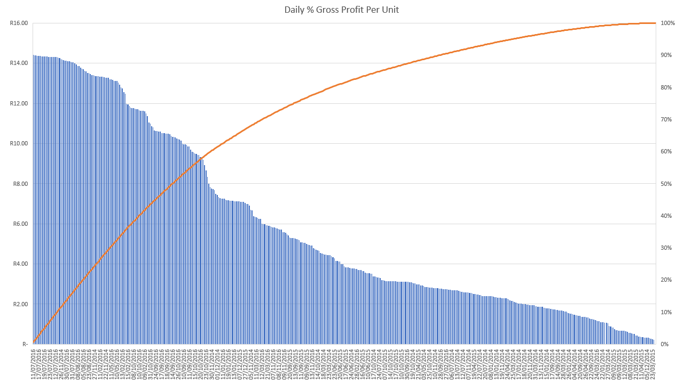

Slide 8
Additional Insights;

